Slide 1
Electronic Control Units & AUTOSAR

Slide 2

Agenda
01
ECU
02
Block Diagrams
03
AUTOSAR

Slide 3

01 - ECU

Slide 4
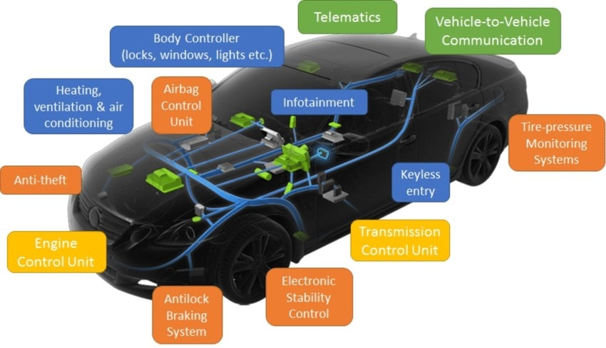
ECU
ECU Diagram
Overview
{image check copyrights – Wikipedia great source of free to use imagery}
Definition: ECU (Electronic Control Unit) – responsible for controlling different parts of the car
Importance: Understanding what each ECU is responsible for provides context for how the car operates
Examples of ECUs:
Engine Control Module
Transmissions Control Module
ABS ECU – Antilock Braking System
ESC ECU – Electronic Stability Control
Notes:
The ECM
Regulates the air and fuel intake to produce an efficient system
Controls the timing of spark plug firing
The TCM
Controls gear shifting for automatic vehicles
Regulates hydraulic pressure within the transmission to make gear shifting smoother
ABS ECU
Monitors wheel speed sensors
Detects warning signs such as one wheel moving significantly faster than the others
Modules that hyrdaulic pressure at each wheel to prevent lockup
ESC ECU
Builds upon ABS functionality
Interprets data from wheel speed sensors, steering wheel angle, yaw rate
Detects things like skidding, oversteering, understeering
Modules engine power and selectively applies brakes to wheels to maintain stability

Slide 5
ECUs
Notes:
This slide demonstrates a lot of the different ECUs in a car. Can talk about a handful of them from a general perspective

Slide 6
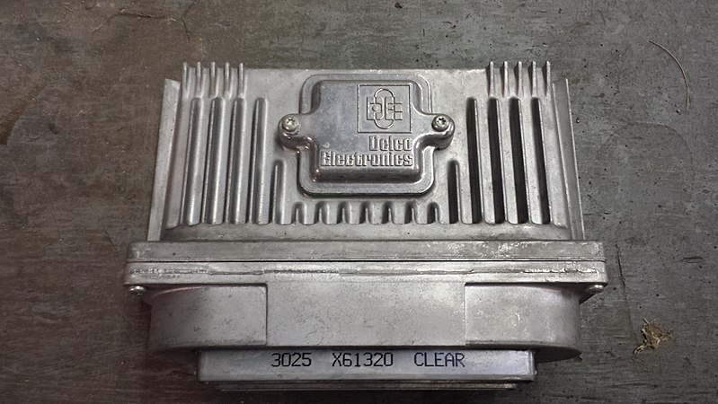
ECM
1996 Chevrolet Beretta ECM
Overview
Definition: The Engine Control Module is responsible for managing engine-related operations
Importance: The ECM helps optimize the engine and ensures adherence to regulations
Efficiency and Optimization
Emissions Regulations
Notes:
Image taken from: https://commons.wikimedia.org/wiki/File:An_ECM_from_a_1996_Chevrolet_Beretta-_2013-10-24_23-13.jpg
This file is licensed under the Creative Commons Attribution-Share Alike 3.0 Unported license.
Note that there are many more ECUs to learn about.
Efficiency – By regulating fuel injection and air flow, the ECM ensures the engine runs efficiently and optimizes performance
Regulations – The ECM also ensures compliance by regulating emissions

Slide 7
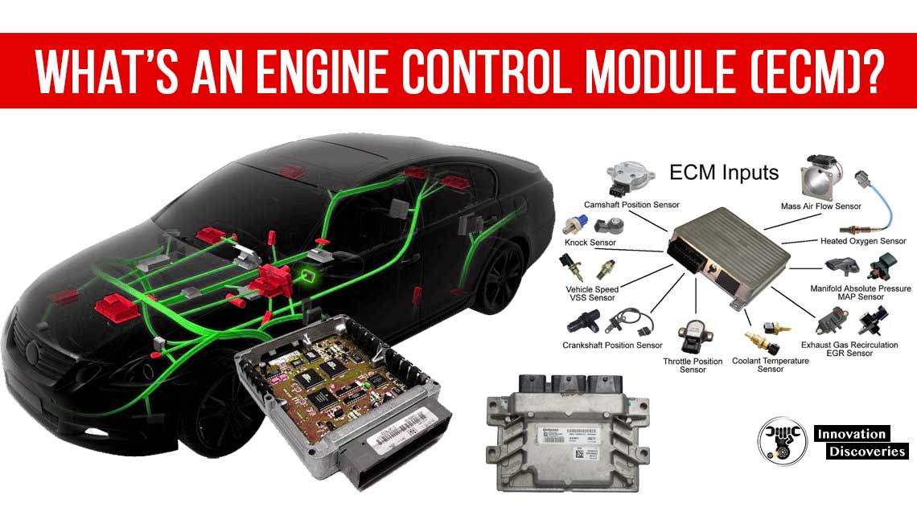
ECM:

Slide 8
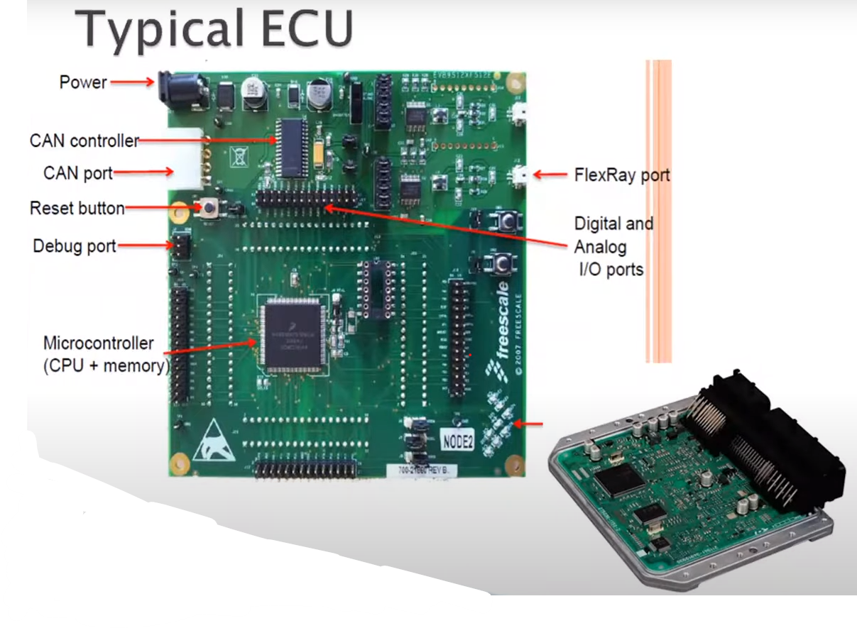




ECUs

Slide 9
02 – Block Diagrams

Slide 10
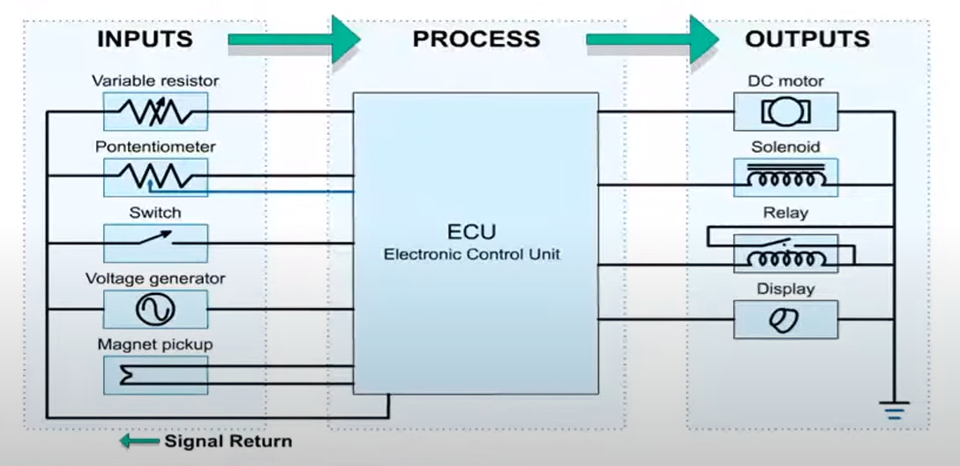
Block Diagrams
Sample Block Diagram
Overview
Definition: Block Diagrams are visual representations of a system, using blocks and arrows to indicate components and connections, respectively
Importance: Block Diagrams help to simplify the process of understanding automotive systems
Blocks - Components
Arrows - Connections
Annotations – Labels
Notes:
Blocks – Represent a component or subsystem within the overall system
Arrows – Represent a connection between 2 components/systems
Annotations – Textual labels that provide additional information

Slide 11
ECUs
Notes:
Note that this block diagram indicates the inputs to the ECU as well as the outputs that are affected by it.
Can give an example: Based on the state of the switch (open/closed), the ECU can in turn regulate the speed at which the motor rotates.

Slide 12
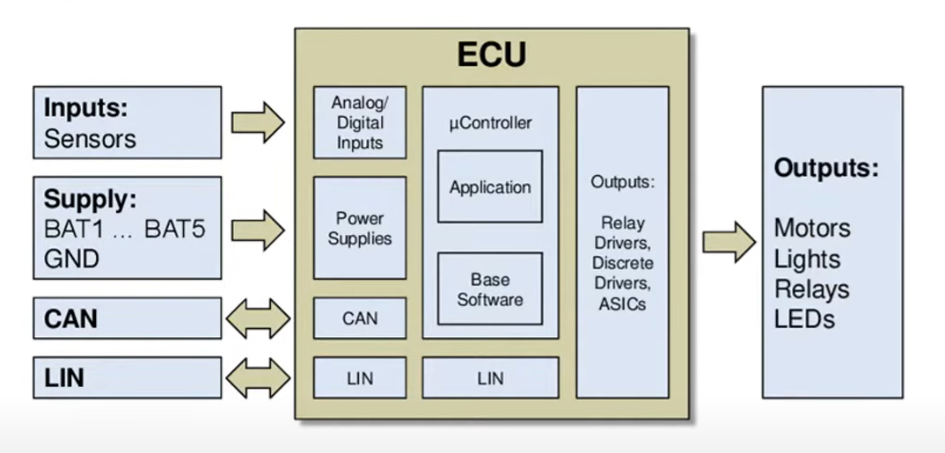
ECUs
Notes:
Here, we see even more detali is put into the ECU component of the diagram

Slide 13
03 – AUTOSAR

Slide 14
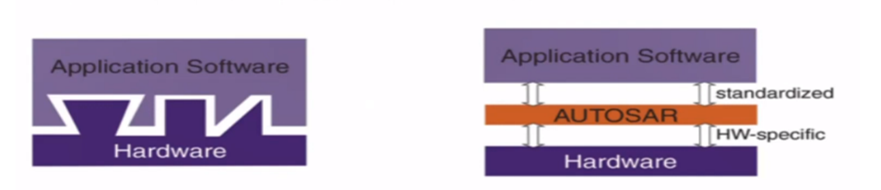
AUTOSAR
AUTOSAR Overview
Overview
Definition: AUTOSAR (AUTomotive Open System ARchitecture) is a standardized framework for ECU software development
Importance: AUTOSAR makes the process of writing software for ECUs smoother in multiple ways:
Standardization
Scalability
Safety and Security
Notes:
On the top, we see that software is highly dependent and there would be a considerable amount of effort into relocating/modifying functions.
However, on the bottom, the software is largely indepdnent of the chosen microcontroller. This creates a more simplified development process and encourages the reuse of software
Standardization – The existence of a standard architecture makes the development of software cheaper and less time-consuming
Scalability – AUTOSAR components are modular in nature, thus achieving reusability and scalability
Safety and Security – AUTOSAR is designed with security in mind

Slide 15
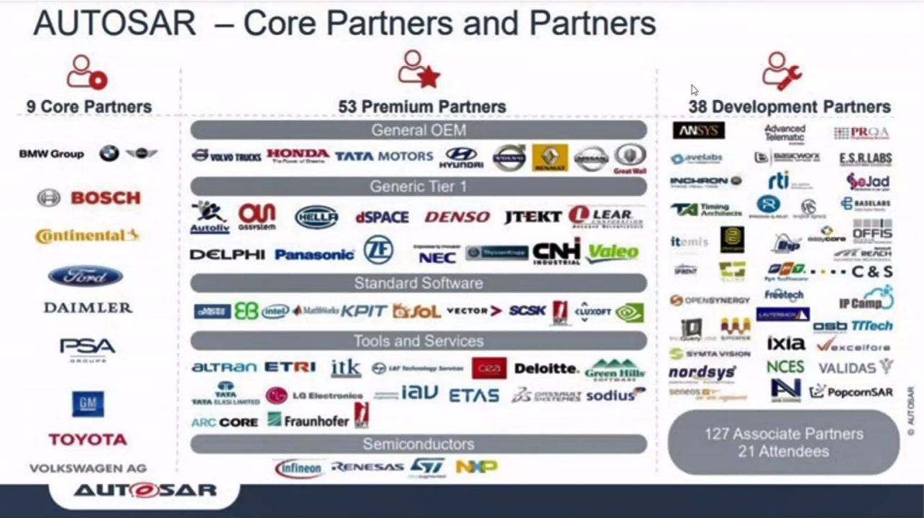
Notes:
AUTOSAR – Automotive Open System Architecture
Open standard enables use of component-based software design model
Tier 1 Direct Supplier of Original Equipment Manufacturer (OEM)

Slide 16
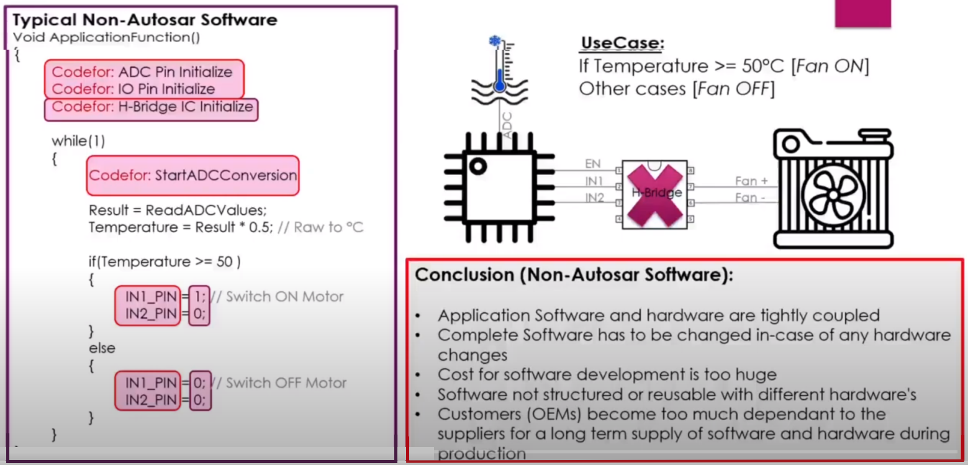
Practice Use-Case Classic Software
Notes:
Conclusion (Non-Autosar Software):
Application Software and hardware are tightly coupled
Complete Software has to be changed in-case of any hardware changes
Cost for software development is too huge
Software not structured or reusable with different hardware's
Customers (OEMs) become too much dependant to the
suppliers for a long term supply of software and hardware during production

Slide 17
Appendix I – A Deeper Look at AUTOSAR

Slide 18
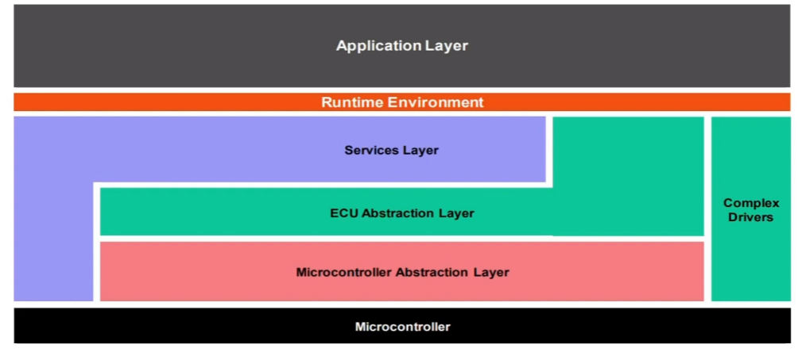
AUTOSAR Layers
Notes:
Application Layer – first layer of AUTOSAR software arch supporting custom functionalities implementation. Consissts of specific software components & many applications which perform specific tasks as per instructed. Such as dimming the light of a vehicle.
Runtime Environment – layer providing comm services to the application software to communicate between different ECUS, within the same ECU and between services & layers via RTE
Complex Device Driver – creating non-standard functionality within BSW stack. When functionality requires strict timing constraints which may be lkesser than the min timing of AUTOSAR OS resolution, such like injection control electric valve control, incremental positions detection

Slide 19
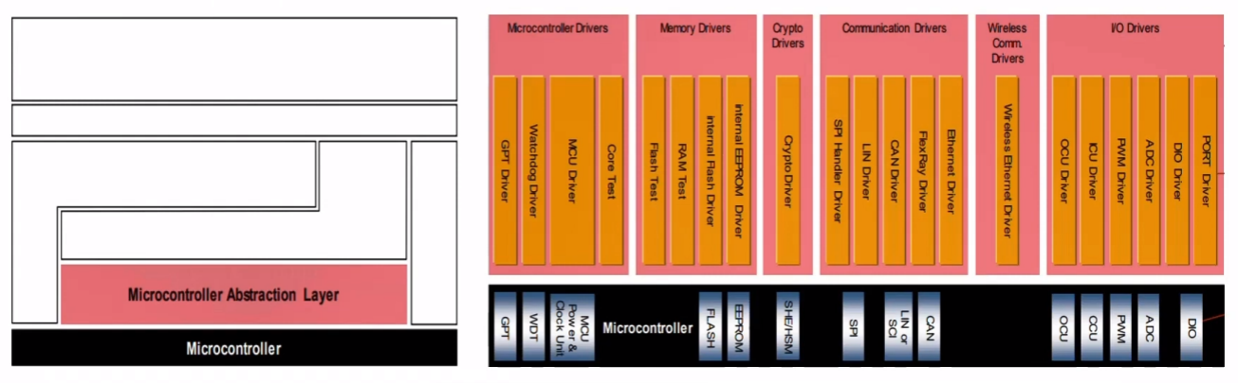
Microcontroller Abstraction Layer
MCAL lowest software layer
Contains internal drivers – software modules with direct access to the microcontroller and internal peripherals

Slide 20
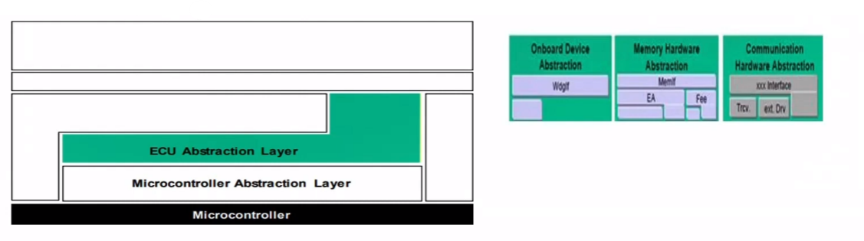
ECU Abstraction Layer
Interfaces driver of Microcontroller lay & contains driver for external devices
API for access to peripherals & devices regardless of location

Slide 21
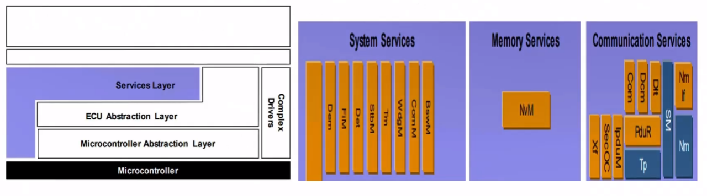
Service Layer
Highest layer of basic software
Provide services to/from application layer to/from microcontroller
Offers OS functionality, vehicle network comms & management, memory services, Diagnostic Services, ECU state & monitoring

